Slide 1
Notes about the deck
Goal of the deck
Provide .NET positioning, momentum and market data (Why .NET?)
Provide good technical information to understand the pieces, how the platform is innovating and roadmap strategy
Things that should be clear
.NET is a unified platform for building any app on any device or OS
.NET is strategic to the company and we’re innovating and expanding its reach
.NET Core optimized for server/cloud and device workloads
.NET Core and Mono/Xamarin open sourced under the .NET Foundation

Slide 2
Understanding .NET

Slide 3
Why .NET?

Slide 4
Any developer Any app Any platform
VISUAL STUDIO
ASP.NET
AZURE LINUX VM
VISUAL STUDIO CODE
C#
iOS DEVICE
XAMARIN STUDIO
C++
AZURE WINDOWS VM
EMACS
NODE.JS
ANDROID DEVICE
VIM
PYTHON
AZURE CONTAINER SERVICE
VISUAL STUDIO
HTML/JS
WINDOWS DEVICE
VISUAL STUDIO CODE
.NET
AZURE
XAMARIN STUDIO
C#
AZURE LINUX VM
EMACS
C++
iOS
DEVICE
VIM
NODE.JS
AZURE WINDOWS VM
PYTHON
ANDROID DEVICE
HTML/JS
AZURE CONTAINER SERVICE
WINDOWS DEVICE
AZURE WEB APP
Notes:
Before going deep on .NET, we should highlight that the Microsoft platform allows using any technology. Our goal is to enable any combination of development tool, development technology and targeted platform. And that applies to any combination. You can target Azure with any development technology, or you may decide to target Linux on-premises with Node.js but use Visual Studio, or use Visual Studio for Mac with .NET to target iOS. That’s the principle behind the “any developer, any app, any platform”.

Slide 5
Why .NET? End-to-end solution Maximum productivity Modern Applications
ASP.NET
AZURE LINUX VM
VISUAL STUDIO
C#
iOS DEVICE
VISUAL STUDIO CODE
C++
AZURE WINDOWS VM
XAMARIN STUDIO
NODE.JS
ANDROID DEVICE
EMACS
PYTHON
AZURE CONTAINER SERVICE
VIM
HTML/JS
WINDOWS DEVICE
VISUAL STUDIO
.NET
AZURE
VISUAL STUDIO
.NET
AZURE
VISUAL STUDIO CODE
C#
AZURE LINUX VM
XAMARIN STUDIO
C++
iOS
DEVICE
EMACS
NODE.JS
AZURE WINDOWS VM
VIM
PYTHON
ANDROID DEVICE
HTML/JS
AZURE CONTAINER SERVICE
WINDOWS DEVICE
AZURE WEB APP
Notes:
Then, why .NET? Even if the Microsoft platform is opened for any technology, we believe .NET is a huge differentiation for Enterprise development as it provides an already connected, fully integrated end to end solution. Using Visual Studio, .NET and the Microsoft platform brings the maximum productivity to developers. Everything is meant to just work out of the box. And it comes with integrated DevOps and prescriptive architectures and libraries to create modern applications, all aligned and supported avoiding the wild west of using different misaligned technologies.

Slide 6
Best of both worlds Enterprise scale Modern applications
.NET Compared
Traditional
technologies
(Java, C++…)
.NET
Enterprise scale
Modern
technologies
(Node.js, Go…)
Modern applications
Notes:
Traditional technologies are struggling to meet these new demands. Application patterns such as device native cross-plat or cloud microservices are very challenging if not impossible to meet with traditional technologies.
That is causing developers in these technologies to move to other modern technologies such as Node.js or go, but these technologies are far from being optimized for the Enterprise. They lack scalability at many angles such as number of users, team size or application complexity and they don’t play well with our existing investments or legacy systems.
.NET has the best of both worlds. It is with Java the main technology used in Enterprise applications but it has been modernized to meet the new modern demands of applications.

Slide 7

.NET momentum
61%
YoY Growth .NET Active Developers
(VS 2012+)
.NET Core
Xamarin
40%
.NET Core users not previously using .NET
Java #1 source (18%)
Windows
Web
Growth by .NET application type (%)
Notes:
And we are seeing this already by ourselves. This combination of Enterprise-readiness with modern applications is causing .NET to experience a new golden age. Just last year we’ve seen a 61% increase in .NET developers worldwide (measured via VS 2012+ telemetry), something crazy considering the already high adoption of .NET.
When you look at the components causing that growth you can see on the right that traditional application patterns in .NET such as Windows development and Web development are growing 10 to 20% annually but the exponential growth is happening in modern applications, with huge increases of 400% in .NET Core or 250% in Xamarin.
That growth is caused by existing .NET developers embracing these new application patterns but also net new developers. 40% of .NET Core users are new developers to .NET. The number 1 technology previously used: Java.

Slide 8
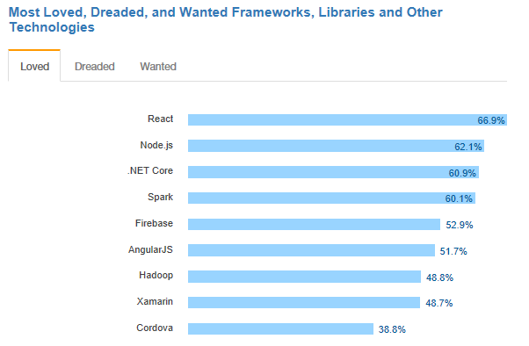
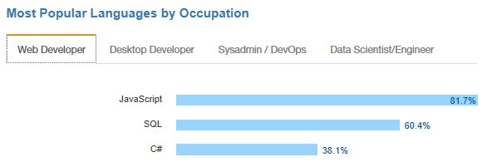
.NET is loved
.NET Core debuts at #3 most loved Framework on Stack Overflow Technology Survey 2017
C# is #3 most popular language for desktop and web developers on Stack Overflow Technology Survey 2017
Source: http://stackoverflow.com/insights/survey/2017

Slide 9

Customers & community are talking about .NET
Hacker News appearances of .NET or Visual Studio products (bars are count of articles, line is total votes)
https://www.microsoft.com/net/customers
“Using the same-size server, we were able to go from 1,000 requests per second per node with Node.js to 20,000 requests per second with .NET Core.“
— Raygun
“Developers can reuse their C# skills to build native Android, iOS, and Windows applications that deliver the right information to the right person at the right time.“
— Alaska Airlines
“We believe .NET elegantly handles the trade-off between developer productivity and application performance.“
— National Instruments
“The Microsoft technology made it easy for us. It just works. We saved months of development time in the process.“
— Stackoverflow.com

Slide 10


.NET Open Source momentum
Community PRs by month
ASP.NET Core
IdentityManager
MEF
.NET Core
Mono
Mailkit
Kudu
Cecil
Microsoft Azure SDK for .NET
Cake
Xamarin.Auth
xUnit.net
Open Live Writer
Mimekit
Nancy
WCF
Couchbase Lite for .NET
ASP.NET Web Pages
Umbraco
LLILC
Orchard CMS
System.Drawing
IdentityServer
ASP.NET MVC
Open XML SDK
NuGet
OWIN Authentication Middleware
Polly
Orleans
Microsoft Azure WebJobs SDK
Prism
Xamarin.Mobile
Salesforce Toolkits for .NET
ASP.NET SignalR
Xamarin SDK
ASP.NET Web API
.NET SDK for Hadoop
WorldWide Telescope
Entity Framework
Benchmark.NET
MVVM Light Toolkit
.NET Compiler Platform ("Roslyn")
MSBuild
ProtoBuild
ASP.NET AJAX Control Toolkit
http://www.infoworld.com/article/3149765/application-development/win-win-open-source-net-pays-off-for-devs.html
Notes:
Open Source has been a key factor on this growth. We are seeing tremendous growth on community participation. For example, 60% of contributions to .NET Core and related repos are actually coming from the community, which basically means we doubled the capacity to innovate on .NET. And this also helps us to create a better product, higher quality and aligned with customer demands. It also had a huge impact on the ecosystem. .NET open source and component ecosystem has skyrocketed in the last 2 years.
The other important thing to remember is that we didn’t compromise Enterprise readiness with this increased openness. The .NET platform is fully supported by Microsoft like any other service or product. We take community contributions but we are accountable for them and we treat them as any other Microsoft contribution with testing, security, patent scanning and full support.
http://www.infoworld.com/article/3149765/application-development/win-win-open-source-net-pays-off-for-devs.html

Slide 11






Technical Steering Group
Notes:
We also opened the .NET product strategy for the industry to participate. We believed the model used in .NET is the perfect combination of agility and consensus. We open the conversation to the community and even more deeply with the technical steering group which represents key players in the industry, but there’s no committee approval needed for every single feature which slows down other technologies like Java.

Slide 12
What is .NET?

Slide 13


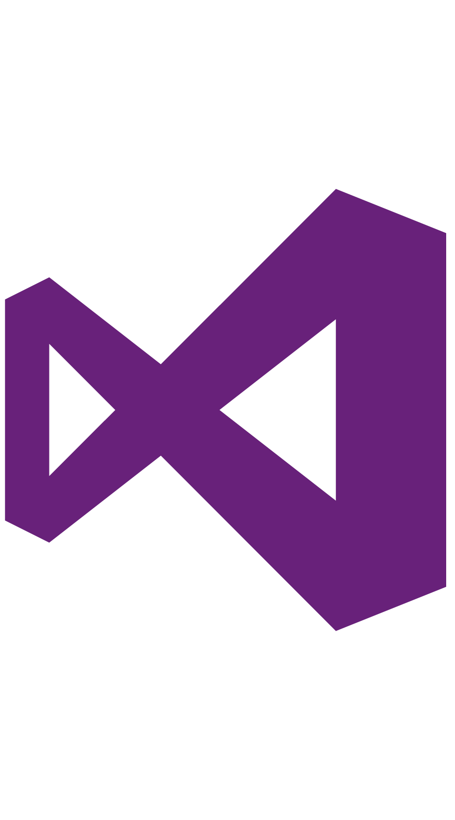

.NET – A unified platform
.NET FRAMEWORK
.NET CORE
XAMARIN
TOOLS
WPF
Windows Forms
UWP
iOS
Android
Visual Studio
ASP.NET
ASP.NET Core
OS X
.NET STANDARD LIBRARY
Visual Studio for Mac
Visual Studio Code
COMMON INFRASTRUCTURE
Compilers
Languages
Runtime components
Command Line Interface
Notes:
When we talk about .NET we’re talking about an entire unified platform and ecosystem. With Mono now under the .NET Foundation we can steer the direction of all of these implementations more easily. Each .NET implementation be that .NET Framework, .NET Core, or Mono for Xamarin & Unity, share the same common infrastructure and .NET Standard library. This means not only are your .NET skills portable, but your actual binaries are portable across implementations.
Additionally, there are a broad set of development tools and applications frameworks that enable you to literally build any app for any platform with any operating system --- all with .NET
See: https://docs.microsoft.com/en-us/dotnet/articles/standard/components

Slide 14
.NET: Major Investment Areas
TRADITIONAL EXPERIENCES
Windows desktop and server applications
.NET FRAMEWORK
.NET
Standard
Modern CLOUD EXPERIENCES
OSS .NET for modular, Enterprise-ready microservices
.NET CORE
MODERN DEVICE EXPERIENCES
Only platform providing native, cross-plat experiences
UWP
mono (XAMARIN & UNITY)
Notes:
We will continue to invest in the .NET Framework but with a much higher compatibility bar. As a component of Windows, we have over 1.8 Billion installations on Windows and take this very seriously. Critical bug fixes and low impact or critical features will be added but not at a fast pace. We want to keep the apps you have running.
.NET Core is our newest, fastest, cross-platform, open source implementation of .NET that will take us to the next 15 years. It is built for cloud-native and small device workloads that can be deployed with the app in a small container. .NET Core is where we innovate quickly with the community in the open on GitHub. This is the nature of open source. Because .NET Core is cross-platform (Windows, macOS, multiple distros of Linux), we’ve decoupled .NET Core support policy from the operating system. We take a model of Long-Term-Support (LTS) on major versions for 3 years.
Now with Mono officially under the Microsoft umbrella as well as Universal Windows Platform, we are focused on fantastic experiences for mobile devices. You will see innovation from Windows (and Unity for Hololens for instance) as well as iOS an Android solutions with Xamarin.
As we bring .NET everywhere we focus on these implementations. .NET standard is what brings these implementations closer together. Think of it as the “new base class libraries” which you build upon and can reuse the binaries in other runtimes that implement the standard. All runtimes supported by Microsoft implement the standard (.NET Framework, .NET Core, Mono).

Slide 15
.NET Standard brings it all together
.NET Standard allows sharing code, binaries and skills between .NET client, server and all of its flavors.
.NET Standard provides a specification for any platform to implement (conceptually similar to HTML)
All .NET runtimes provided by Microsoft are implementing the standard
TRADITIONAL WINDOWS
CLOUD MICROSERVICES
WINDOWS 10
IOS, ANDROID
GAMES / 3D
.NET STANDARD
LIBRARIES
INFRASTRUCTURE
COMPILERS
LANGUAGES
RUNTIME COMPONENTS
Notes:
When we talk about .NET we’re talking about an entire unified platform and ecosystem. Any workload on .NET supports .NET Standard going forward. With Mono now under the .NET Foundation we can steer the direction of all of these implementations more easily. Each .NET implementation be that .NET Framework, .NET Core, or Mono for Xamarin & Unity, share the same common infrastructure and .NET Standard library. This means not only are your .NET skills portable, but your actual binaries are portable across implementations.
You can think of the .NET Standard to HTML5 – it’s a specification of HTML that browsers must implement. Similarly, the .NET Standard defines the API’s that all the .NET’s must implement. This is the promise of .NET Everywhere.
See: https://docs.microsoft.com/en-us/dotnet/articles/standard/components

Slide 16
.NET Standard 2.0
Has much bigger API surface
Extended to cover intersection between .NET Framework and Xamarin
Also makes .NET Core 2.0 bigger as it implements .NET Standard 2.0
+20K
More APIs than
.NET Standard 1.x
Can reference .NET Framework libraries
Compatibility shim allows referencing existing .NET Framework binaries
No recompile required – also covers existing NuGet packages
Limited to libraries that only use APIs that are available for .NET Standard
~70%
of NuGet packages
are API compatible

Slide 17
Why .NET Core?

Slide 18
The cloud journey
Servers
VMs
IaaS
VMs / Containers
PaaS
Microservices
Benefits
Reduced IT costs Cloud-native performance and scalability
Faster development times Build on common services
Agility Continuous delivery and innovation
On-premises servers
Cloud Infrastructure
Born in the Cloud
Notes:
Why .NET Core? As enterprises move through their cloud journey we’re now at a point where we need a cloud native development platform that can take full advantage of Platform as a Service (PaaS) offerings in any cloud, and hyper-scale. Applications that are born and hosted in the cloud provide a number of key benefits like reduction of IT spend, faster development times by taking advantage of cloud platform services, and increased agility with DevOps. Additionally, at the other end of the spectrum, we have small devices & IoT that we can support with .NET Core as it leaves a much smaller footprint than previous .NET frameworks.

Slide 19
.NET and Containers
Azure
Linux
Windows Server 2016
Notes:
.NET Core is a perfect choice for building containerized architectures and microservices and hosting them on any platform. But even .NET Framework applications built many years ago as monolithic services can take advantage of Windows Containers.

Slide 20
Continuous Integration with Containers
Container based CI/CD with Visual Studio Team Services
Azure Container Service
Shopping Cart Service
Azure Container Registry
Catalog Service
Inventory Service
WEB APP
Shipping Service
Account Service
Visual Studio
Notes:
.NET, Visual Studio and Azure provide a complete end-to-end DevOps solution. Develop on your favorite OS with your favorite Editor or IDE like Visual Studio, then use Visual Studio Team Services to set up a continuous integration and deployment pipeline for your containerized applications & services into Azure.

Slide 21
.NET Core and containers
Health monitoring
Container health check endpoint
Tracing
Distributed tracing with correlation IDs
Configuration
Distributed configuration and secret management
Protocols
Non-HTTP (binary, message queues…)
Service discovery
Abstracted discovery mechanism for services
Notes:
We are continuously improving .NET Core for the best experience when running in containers.

Slide 22
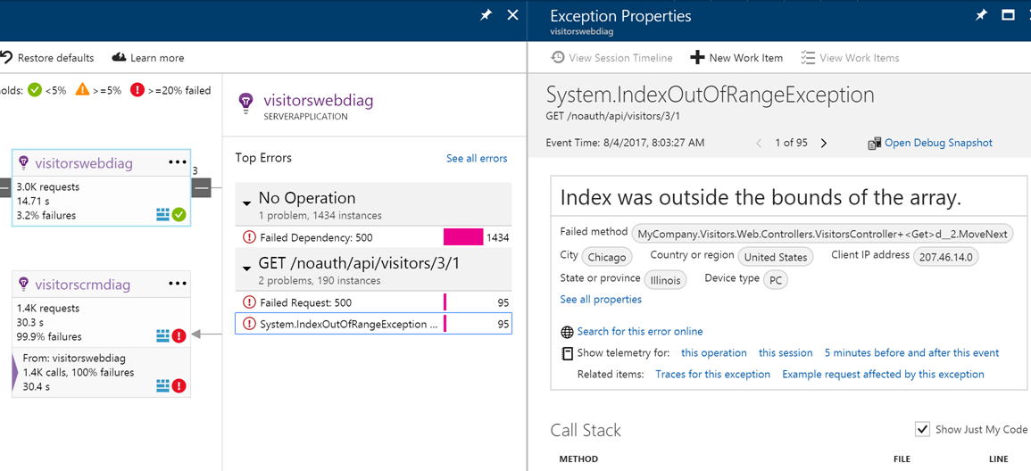
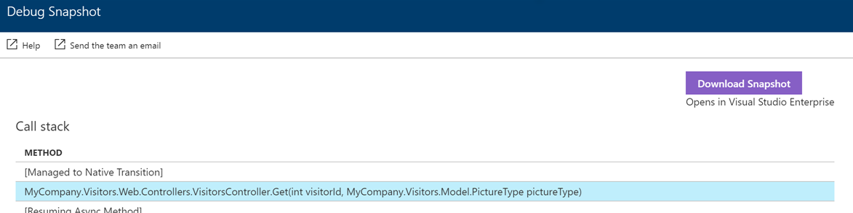
Cloud and Container diagnostics
Should be simple
No modifications to your app
No republishing of your app
From the Azure Portal
Enable/Disable analytics and diagnostics
See common crashes and performance problems including seeing code
From Visual Studio
See analytics data from portal in real time
Use “snap points” to debug a running application
Notes:
With the .NET Core 2.0 release we also improved Azure diagnostics and live analytics in App Service. Enable/Disable while the application is running in production with no code changes. Azure will take snap points on anomalies it sees (exceptions, slow performance) where you can analyze and open the full stack traces to debug right in Visual Studio.

Slide 23




.NET Core is optimized for “cloud-native” apps
Cross-platform
Windows, Linux and macOS.
Fast
Top 10 fastest web stack on TechEmpower benchmarks
Lightweight
No impact deployment and a modular development model perfect for containers
Open source
Runtime, libraries, compiler, languages and tools developed in the open in GitHub
aspnetcore-linux
aspnetcore-mvc-linux
Notes:
https://www.microsoft.com/net/core/platform
http://www.techempower.com/benchmarks/#section=data-r13&hw=ph&test=plaintext

Slide 24
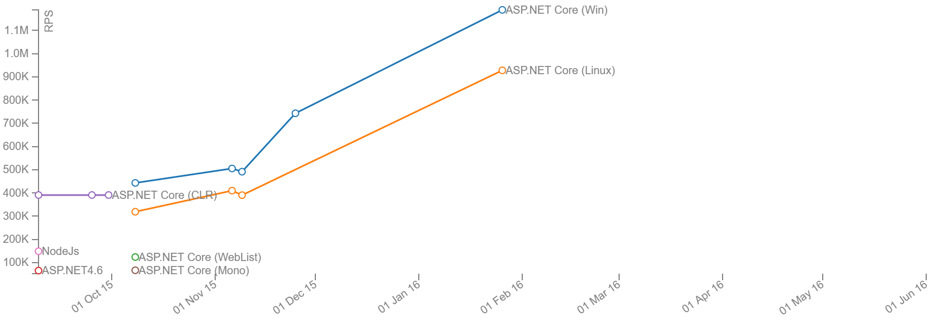
Age of Ascent Benchmarks
http://web.ageofascent.com/asp-net-core-exeeds-1-15-million-requests-12-6-gbps/
ASP.NET 4.6
ASP.NET Core
on CoreCLR
aspnetcore-linux
aspnetcore-mvc-linux
Notes:
One of our customers (see customer stories section) Illyriad games has contributed much of the performance improvements to ASP.NET Core which is now over 10X faster requests per second than ASP.NET 4.6.

Slide 25
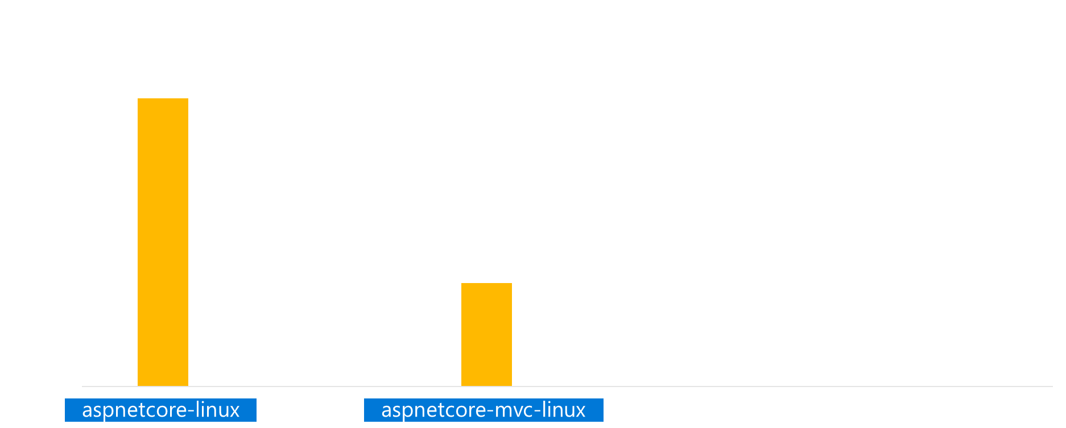
TechEmpower 13: ASP.NET Core performance
ASP.NET Core 2.0 = 20% faster than 1.1
aspnetcore-linux
aspnetcore-mvc-linux
https://www.techempower.com/blog/2016/11/16/framework-benchmarks-round-13/
Notes:
NEW NOTE: ASP.NET Core 2.0 is 20% faster than this in our labs. New Techempower round coming soon.
ASP.NET Core 1.1 is ranked in the top 10 best performing frameworks in the plaintext test above Java (servlet), Go, and Node.js. ASP.NET MVC is the top performing full-stack framework.
See Full Benchmarks:
https://www.techempower.com/benchmarks/#section=data-r13&hw=ph&test=plaintext
Quote from:
https://www.techempower.com/blog/2016/11/16/framework-benchmarks-round-13/
“Thanks to Microsoft’s herculean performance tuning effort, ASP.NET—in the new cross-platform friendly form of ASP.NET Core—is now a top performer in our Plaintext test, making it among the fastest platforms at the fundamentals of web request routing. The degree of improvement is absolutely astonishing, going from 2,120 requests per second on Mono in Round 11 to 1,822,366 requests per second on ASP.NET Core in Round 13. That’s an approximately 85,900% improvement, and that doesn’t even account for Round 11’s hardware being faster than our new hardware. That is not a typo, it's 859 times faster! We believe this to be the most significant performance improvement that this project has ever seen.”

Slide 26
Performance improvements in .NET Core 2.0
Base class libraries (CoreFX)
The community has submitted many of these performance improvements
RyuJIT – Just-in-time IL compiler
Benefits .NET Core and .NET Framework
Profile-guided optimization
Improvements to generate better optimized code for native components
“Using the same-size server, we were able to go from 1,000 requests per second per node with Node.js to 20,000 requests per second with .NET Core.“ — Raygun
https://www.microsoft.com/net/customers
Notes:
The 2.0 release we worked really hard on performance improvements up and down the entire stack.
https://blogs.msdn.microsoft.com/dotnet/tag/performance/

Slide 27
Why Xamarin?

Slide 28
The mobile app dilemma
Native
End user experience
Hybrid
Better TCO, productivity and development experience
Notes:
One option is the silo’ed approach – today, it is very common to see a company or developer create the same app multiple times in different languages with different tools for different platforms
While this might give you a fully native user experience and maximum performance, it is also expensive, can require multiple teams and generally takes more time
But the biggest issue of this approach is the future maintenance overhead of managing and maintaining apps and code for multiple different platforms

Slide 29
Cross-platform native with Xamarin
“The best of both worlds”
End User
Platform-native UX
Full performance
Native platform service integration
C#
End user experience
Developer
100% C# with 100% of platform APIs exposed
More productivity and faster development
Up to 95% code reuse across platforms
Up to 100% shared UI with Xamarin.Forms
One code base & IDE for client and backend
Better TCO, productivity and development experience
Notes:
Mobile is transformative because mobile apps are context-aware – and context-aware apps require full access to native device capabilities
Mobile users - consumers and employees alike - are more likely to abandon apps that show poor performance or non-standard UI, navigation and controls because it slows them down and forces them to re-learn things they already know
Xamarin takes .NET to the next level and extends it to iOS and Android
Xamarin apps are 100% C# and 100% of Android + iOS platform APIs are exposed
With Xamarin, everything you can do with Objective-C or Java, you can do with .NET
Xamarin apps are 100% native apps, indistinguishable from platform-native apps created with Android Studio, Eclipse or Xcode
Xamarin also includes powerful iOS and Android UI designers that enable you to create beautiful user experiences for Windows, iOS and Android in a visual designer with drag-and-drop simplicity
Xamarin enables developers to use the same languages, libraries, and tools for all major mobile platforms, unlocking the extraordinary productivity of .NET for any iOS and Android while using existing skills and enabling effortless sharing of code among platforms
With Xamarin, you can build native apps once and run them everywhere – giving developers the most productive and powerful platform for creating native cross-platform applications
The cross-platform native approach combines the benefits of both worlds - you get the native user experience for each individual platform, and you also eliminate rework and increase organizational innovation and responsiveness by delivering more apps faster

Slide 30
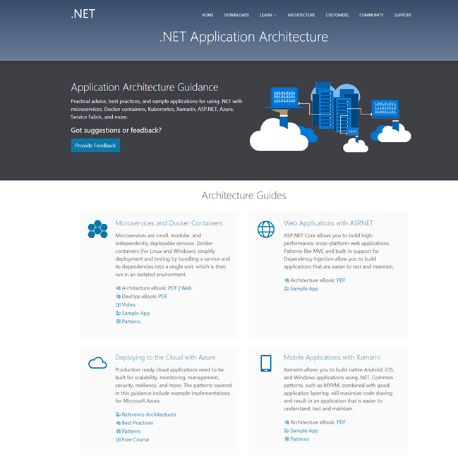
Available now at: https://dot.net/architecture
eBooks & samples: Web, Containers, mobile
Patterns: Health checks, queueing
More books and patterns coming…
Notes:
As we move .NET to the future, we’re committed to helping you learn these new application patterns. Visit the new architecture center to learn how.

Slide 31
What do I need to know?
As a developer,
Notes:
What developers need to know to get started

Slide 32
.NET Runtimes
.NET FRAMEWORK
.NET CORE
XAMARIN
Platform for .NET applications on Windows
Cross-platform, open source framework for modern cloud-native and UWP apps
Cross-platform, open source Mono-based runtime for iOS, OS X, and Android devices
Distributed with Windows
Distributed with app*
Distributed with app
Notes:
*.NET Core can be distributed with the application and can run side-by-side or can be deployed globally on the target OS. In the case of UWP, it is compiled AOT with the .NET Native toolchain which produces native binaries. (more details on slide 38)
.NET Framework
.NET Framework is the original .NET runtime that has existed since 2002. It is the same .NET Framework existing .NET developers have always used. It implements the .NET Standard Library, which means that any code that targets the .NET Standard can run on the .NET Framework. It contains additional Windows-specific APIs, such as APIs for Windows desktop development with Windows Forms and WPF. .NET Framework is optimized for building Windows desktop applications. It is distributed with the Windows Operating System and is serviced with Windows Update. The framework is shared system wide with applications running on the machine. Applications are JIT compiled (Just in Time) on first use which allows for maximum portability across Windows desktops & servers.
NET Core
.NET Core is a cross-platform runtime optimized for server and small device workloads. It implements the .NET Standard Library, which means that any code that targets the .NET Standard can run on .NET Core. It is the runtime used by ASP.NET Core and the Universal Windows Platform (UWP). It is modern, efficient, and designed to handle server and cloud workloads at scale. .NET Core can be distributed with the application and can run side-by-side or can be deployed globally on the target OS. In the case of UWP, it is compiled AOT with the .NET Native toolchain which produces native binaries.
Mono for Xamarin
Mono is the runtime used by Xamarin apps. It implements the .NET Standard Library, which means that any code that targets the .NET Standard can run on Xamarin apps. It contains additional APIs for iOS, Android, Xamarin.Forms, and Xamarin.Mac. It is optimized for building mobile applications on iOS and Android. In It is compiled AOT which produces native binaries for each .

Slide 33
.NET Languages
C#
Powerful, flexible, for any kind of app
Innovate aggressively and responsibly bringing latest language trends to enable modern applications
VB
Easy to get started, approachable
Focus on simplicity and productivity for the most common scenarios and developers new to programming
F#
Productive functional programming and analytics
Be the most productive functional language in the market with full integration and interoperability with .NET
Notes:
.NET has three languages sponsored by Microsoft. There are many other .NET languages in the community but these are the three main ones that have great support in Visual Studio family of tools.
C# Language Strategy
We will keep growing C# to meet the evolving needs of developers and remain a state of the art programming language. We will innovate aggressively, while being very careful to stay within the spirit of the language. C# is used by millions of people. C# is among the most widespread programming languages on the planet. The diversity of target scenarios is staggering, ranging across games in Unity, mobile apps in Xamarin, web apps in ASP.NET, business applications on Windows, .NET Core microservices on Linux in Azure and AWS, and so much more. The 2016 Stack Overflow developer survey shows C# as one of the most popular programming languages and also one of the few big mainstream languages to figure on the most loved top 10 in the StackOverflow survey.
VB Language Strategy
We will keep Visual Basic straightforward and approachable. We will do everything necessary to keep it a first class citizen of the .NET ecosystem: When API shapes evolve as a result of new C# features, for instance, consuming those APIs should feel natural in VB. We will keep a focus on the cross-language tooling experience, recognizing that many VB developers also use C#. We will focus innovation on the core scenarios and domains where VB is popular. Visual Basic is used by hundreds of thousands of people. Most are using WinForms to build business applications in Windows, and a few are building websites, overwhelmingly using ASP.NET Web Forms. A majority are also C# users. An interesting trend we see in Visual Studio is that VB has twice the share of new developers as it does of all developers. This suggests that VB continues to play a role as a good, simple and approachable entry language for people new to the platform and even to development.
F# Language Strategy
We will enable and encourage strong community participation in F# by continuing to build the necessary infrastructure and tooling to complement community contributions. We will make F# the best-tooled functional language on the market, by improving the language and tooling experience, removing road blocks for contributions, and addressing pain points to narrow the experience gap with C# and VB. As new language features appear in C#, we will ensure that they also interoperate well with F#. F# will continue to target platforms that are important to its community. Looking down the road, we intend to work both with the F# community and other teams at Microsoft to ensure F# tooling is best-of-breed, with the intention of making F# the best-tooled functional programming language in the market.

Slide 34
App Models / Application Frameworks
App models provide APIs for specific types of apps you build
Some app models target a specific runtime & OS
i.e. Universal Windows Platform = Windows operating systems & devices
Some app models can run on multiple runtimes & OSes
i.e ASP.NET Core can run on .NET Framework and .NET Core
.NET FRAMEWORK
.NET CORE
XAMARIN
WPF
Windows Forms
UWP
iOS
Android
ASP.NET
ASP.NET Core
OS X
Notes:
App models (or application frameworks) are built upon the base class libraries and provide additional APIs specific to the type of application you are building (i.e. Web apps and services with ASP.NET; Windows desktop apps with WPF, Windows Forms, Universal Windows Apps; or mobile apps with Xamarin to name a few). Some app models are specific to an operating system and runtime (like UWP, WinForms, WPF is specific to Windows) and some app models can target multiple runtimes and operating systems (like ASP.NET Core can run on .NET Framework or .NET Core or Xamarin.Forms for iOS & Android.)

Slide 35
.NET Standard
Learn one API
Reuse your code across .NET platforms
Easily consume third party / OSS libraries
.NET FRAMEWORK
.NET CORE
XAMARIN
.NET STANDARD LIBRARY
Notes:
https://docs.microsoft.com/en-us/dotnet/articles/standard/library
The .NET Standard Library is a formal specification of .NET APIs that are intended to be available on all .NET runtimes. It’s an API surface area that is guaranteed to be available across all runtimes. The motivation behind the Standard Library is establishing greater uniformity in the .NET ecosystem. It defines the set of Base Class Library APIs for all .NET platforms to implement, independent of workload. This enables developers to build portable libraries and practically eliminates any conditional compilation (only operating system specific APIs may need conditional compilation). This means that library authors can adhere to a .NET Standard library version which guarantees it will run on any runtime that supports that version or higher – effectively future proofing the library.

Slide 36
APIs in .NET Standard 2.0
XML
XLinq • XML Document • XPath • Schema • XSL
SERIALIZATION
BinaryFormatter • Data Contract • XML
NETWORKING
Sockets • Http • Mail • WebSockets
IO
Files • Compression • MMF
THREADING
Threads • Thread Pool • Tasks
CORE
Primitives • Collections • Reflection • Interop • Linq
Notes:
The APIs in .NET Standard 2.0 have greatly expanded. This will help accelerate the ecosystem of libraries across .NET.
https://github.com/dotnet/standard
https://github.com/dotnet/standard/blob/master/docs/faq.md

Slide 37
.NET Standard 2.0 interoperability
MY
.NET FRAMEWORK
APP
MY
.NET CORE
APP
MY
XAMARIN
APP
MY STANDARD LIBRARY
EXISTING
.NET STANDARD LIBRARY
EXISTING
PORTABLE CLASS LIBRARY
EXISTING
.NET FRAMEWORK LIBRARY

Slide 38
How does .NET Standard work?
.NET Standard is represented by:
The NuGet package NetStandard.Library which contains
The reference assembly netstandard.dll
At build time
.NET Standard bridges references to existing .NET Framework and PCL assemblies via type forwarding
At runtime
Each platform provides an implementation for netstandard.dll that type forwards to its implementation

Slide 39
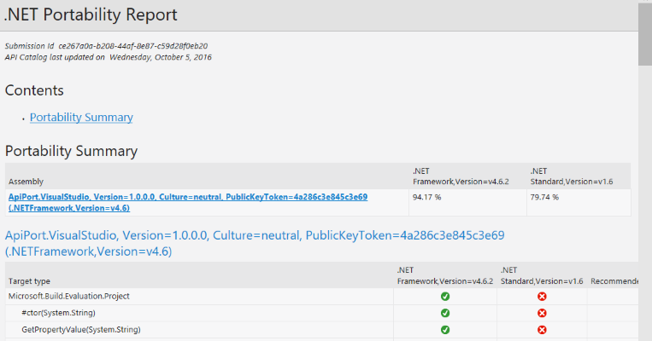

API Portability Analyzer
Helps you determine how portable your application is across .NET Platforms
https://github.com/Microsoft/dotnet-apiport
Console app or Visual Studio Extension
Notes:
Use the API Portability Analyzer from the console or from within Visual Studio to analyze your libraries to see how portable they are across .NET platforms. This helps you determine which version of the .NET standard you can target and helps you evaluate if your .NET Framework libraries can be supported by .NET Core (and Mono).

Slide 40
Tools for any developer and any app
Visual Studio
Visual Studio Code
Visual Studio for Mac
Command Line Interface
OPEN
Any App: Desktop, Mobile, Server, Cloud
Any Developer: IDE, Code editor, CLI
Any OS: Windows, OS X, Linux
POWERFUL
Easy and quick installation
Better productivity with code focus
First-class .NET experiences
Notes:
In addition to a cross-platform .NET Core, we’re also providing tooling for any developer platform and workflow. Whether you develop with a PC or a Mac, we’ve got you covered with a wide range of tooling.

Slide 41

Where do I start?
https://dot.net to understand .NET & get started
https://docs.microsoft.com to read documentation
https://github.com/dotnet open source code starts here

Slide 42
What should I know?
Notes:
What developers should know as they start building .NET apps

Slide 43
.NET Compilers
My code → Intermediate Language (IL)
.NET Compiler Platform “Roslyn” (VB/C#)
F# compiler
IL → Native binaries
JIT (Just-in-Time compiler)
AOT compiler for UWP
Xamarin AOT compiler
Notes:
The .NET Compiler Platform ("Roslyn") provides open-source C# and Visual Basic compilers with rich code analysis APIs. It enables building code analysis tools with the same APIs that are used by Visual Studio. Roslyn produces platform independent Intermediate Language (IL) and is used when building .NET code, including Framework and Core. There are also key language innovations in both VB and C#. See: https://github.com/dotnet/roslyn. There are also innovations happening with F# language and compiler. See https://github.com/fsharp/
“RyuJIT” is the default just-in-time (JIT) compiler for .NET on x64 starting with .NET Framework 4.6. The JIT compiler takes IL and compiles it for the particular machine architecture the first time it is executed at run-time. Used for desktop and server-based scenarios, RyuJIT is an overhaul of the previous 64-bit JIT compiler that significantly reduces startup times. It also includes support for SIMD (single instruction, multiple data) which allows mathematical operations to execute over a set of values in parallel. This can offer a profound speed-up to certain types of apps that rely on vector operations. See: http://blogs.msdn.com/b/dotnet/archive/2013/09/30/ryujit-the-next-generation-jit-compiler.aspx
.NET Native compiles C# and VB to native machine code that performs like C++, so developers continue to benefit from the productivity and familiarity of the .NET Framework with the performance of native code. Typically, apps that target .NET are compiled to intermediate language (IL). At run time, the just-in-time (JIT) compiler translates the IL to native code. In contrast, .NET Native is an ahead-of-time compiler that compiles apps directly to native code and contains a minimal CLR runtime. Popular Windows Store apps start up to 60% faster and use 15-20% less memory when compiled with .NET Native. Universal Windows apps will run on .NET Native (ARM, x86, x64). See: https://msdn.microsoft.com/en-us/library/dn584397(v=vs.110).aspx

Slide 44



Code / Build / Debug
Deploy & Run
Roslyn takes your code and compiles it to IL. You include references to the framework libraries you’re using.
References are built with your app into one native dll deployed locally with runtime
my.exe (stub)
my.dll
Code
(my.cs)
.NET Native tool chain
.NET Native Runtime
Roslyn
UWP
IL
my.dll
+referenced dlls
ASP.NET
JIT Compiler
(RyuJIT)
+
+
CoreCLR
Reference Assemblies
Reference packages & CoreCLR are deployed with app locally, JIT compilation on start up
NuGet Packages
Notes:
Let’s dive deeper into the compilers and where they come into play. You start by writing code and taking references to the libraries you need. Roslyn is the compiler that takes your code and produces platform independent Intermediate Language (IL). Besides the compiler pipeline, there is a rich set of APIs you can use to do all sorts of analysis on your code. If you’re using Visual Studio, there are a ton of new IDE features that utilize these APIs to give you a much more productive coding experience.
If you’re building a Universal Windows App (UWP), the .NET Native tool chain takes it from there. References are built with your app into a native image deployed locally with a minimal runtime. If you’re building an ASP.NET Core app, references and the CoreCLR are deployed with your app locally to the server. JIT compilation then happens on startup using RyuJIT (the totally overhauled in 2015 JIT compiler, and even more perf improvements in 2017: https://blogs.msdn.microsoft.com/dotnet/tag/performance/).
Additionally, ASP.NET Core allows you to make changes in your code, save the changes, and refresh the browser without explicitly re-building the project. Visual Studio uses Roslyn to enable this dynamic compilation. You still have all of the structure and power of a compiled framework, but the development experience feels more like an interpreted language.
Note: If you are targeting .NET Framework 4.6 and higher then you will still enjoy the new innovations in the languages and Roslyn compiler. App deployment doesn’t change from how it’s done today, it still relies on having the full framework installed on the machine, but the JIT compilation happens with the new optimized JIT compiler, RyuJIT.

Slide 45
Common .NET Components
Compilers
Languages
Garbage Collector (GC)
Notes:
Innovations that happen to services like the garbage collector and compilers benefit all the .NET implementations. The GC has some significant improvements to performance starting in .NET Framework 4.6.2 and .NET Core 1.1. See: https://blogs.msdn.microsoft.com/alphageek/2017/01/24/significant-garbage-collector-changes-in-net-4-6-2/

Slide 46
Customer Stories

Slide 47


Age of Ascent – Illyriad Games
Notes:
Age of Ascent, play Video:
https://www.youtube.com/watch?v=XaN-eXkIEbM
This video speaks to the performance and openness of ASP.NET Core and .NET Core.

Slide 48

“Using the same-size server, we were able to go from 1,000 requests per second per node with Node.js to 20,000 requests per second with .NET Core.”
John-Daniel Trask: Chief Executive Officer and Co-Founder Raygun
https://customers.microsoft.com/en-US/story/raygun

Slide 49
“The fact that .NET Core is cross-platform allows developers more freedom in how they develop the product, because at the end of the day, it's going to run on .NET Core, and that will be macOS, Linux, or Windows.”
Jonathan Channon: Software Architect, ASP .NET MVP, VQ Communications
https://customers.microsoft.com/en-US/story/vqcommunications

Slide 50

“We expect to reduce our back-end servers by half. The hardware reduction, combined with the faster development cycle, cut our overall operating costs by 50 percent.”
Feng Zhou: Product Director NetEase
https://customers.microsoft.com/en-US/story/a-top-game-studio-of-netease-transforms-development-and-accelerates-time-to-market-with-net-core

Slide 51



Verizon
Notes:
Video: https://channel9.msdn.com/events/Visual-Studio/Connect-event-2015/055

Slide 52

Notes:
Video: https://www.youtube.com/watch?v=TLZ1EYc-7xc&index=2&list=PLReL099Y5nRfHfSWPgr62FJWGXUxhDlFf

Slide 53

National Instruments
Notes:
National Instruments, play Video:
https://sec.ch9.ms/ch9/7c81/4651052c-9a30-4d3c-b3cf-a7247b6f7c81/NationalInstruments_high.mp4
This video speaks to any app, any developer, any platform = .NET development.

Slide 54

More….
Notes:
https://www.youtube.com/playlist?list=PLReL099Y5nRfHfSWPgr62FJWGXUxhDlFf
https://customers.microsoft.com/en-US/search?sq=.net

Slide 55
Summary

Slide 56

.NET
Everywhere
Device native
.NET
Cloud native
.NET Everywhere
.NET STANDARD LIBRARY
Notes:
.NET was originally built with on premises servers and desktops in mind. As you can see from this presentation, we have re-invented .NET to expand to modern workloads in the cloud and small devices. The .NET Standard library provides that unification of the APIs across .NET implementations and will create a large, sustainable ecosystem for .NET for many years to come. And we’re continue doing it in the open with the innovation from both Microsoft and the community.

Slide 57
.NET roadmap strategy
Continuous innovation at Enterprise scale
Current / LTS trains for maximizing innovation and Enterprise-grade support
1
Best technology for current and future apps
Make .NET the best technology for creating device apps and “cloud-native” services
Apply to traditional patterns to bring innovation and modernization
2
3
Unification and productivity
.NET Standard everywhere and leveraging Visual Studio and Azure synergies
4
Community and Open Source
Invest in first and third party communities through .NET Foundation
aspnetcore-linux
aspnetcore-mvc-linux
Notes:
1 - https://www.microsoft.com/net/core/support
2,3 - https://github.com/dotnet/core/blob/master/roadmap.md
4 - https://dotnetfoundation.org/

Slide 58
.NET
https://dot.net

